Slide 1
AIESEC prakse
Več kot 100 držav sveta

Slide 2
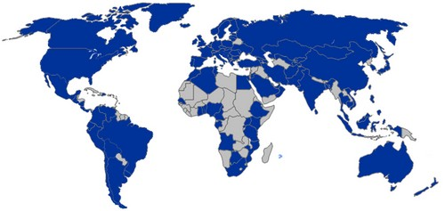
http://www.youtube.com/watch?v=KXaM9oB2rnQ&feature=related

Slide 3
Vrste praks
MT (management traineeship) – business administration, finance, marketing, accounting, organizing events, tourism,…
DT (development traineeship) – work as volunteer in schools, summer camps with children, participate in ecological projects or increase awareness of certain issue among locals.

Slide 4
TT (technical traineeship) – IT sector, web design, computer science, civil engineering, interior design,…
ET (educational traineeship) – teaching languages and get paid for that.

Slide 5
Postopek pridobitve prakse
Intervju
OPS
Dostop do baze

Slide 6
Iskanje prakse
Podpora AIESECa doma in v tujini
Praksa/pošiljanje razglednic

Slide 7
2010 – 10000 izmenjav celotna AIESEC mreža
Od poletja AIESEC Slovenija 31 izmenjav
http://www.aiesec.org/slovenia/ljubljana
matija.resek@gmail.com

Slide 8
